Slide 1
Appendicitis

Slide 2
Introduction
The inflammation of the appendix is the most common cause of acute abdomen in young adults.
Most frequently performed urgent abdominal operation
Incidence
Relatively rare in infants
Common in childhood and early adult life reaching a peak incidence in the teens and early 20s.
Aetiology
Luminal obstruction by a faecolith or a stricture
Proliferation of bacteria
Occasionally obstruction to the lumen of the appendix may be due to a tumour of the caecum →appendicitis

Slide 3
Pathology
Obstruction
proliferation of bacteria
inflammation of the mucosa
transmural spread
serosal layer involved
omentum and loops of intestines gather near the appendix and try to limit the spread of the inflammation to the other parts of the general peritoneal cavity – mass –
At times the infection is very severe and there collects fluid and later pus forms → appendicular abscess.
The inflammation may spread to the general peritoneal cavity and cause generalised peritonitis.

Slide 5
Vermiform Appendix
Cross section

Slide 12
Clinical Features
At an early stage only a colicky abdominal pain
In the beginning the pain is in the periumbilical region
Anorexia, nausea and usually one or two episodes of vomiting.
Similar episodes in the past which settled spontaneously
Progressive inflammation involves the parietal peritoneum and more intense, constant and localised pain results.
Coughing or sudden movement exacerbates the right iliac fossa pain.
The typical picture depicted, is not present in many patients

Slide 13
Fever – 37.2 – 37.7 degree C, pulse rate 80-90
Temperatures more than 38.5degree C may denote mesenteric adenitis.
Two clinical syndromes : acute catarrhal appendicitis, acute obstructive appendicitis.
The latter is marked by very acute course
Tenderness in the RIF – deep palpation of the left iliac fossa may cause pain in the right iliac fossa → ROVSING’S SIGN
Muscle guarding
Lack of respiratory movements in the lower abdomen
When the palpatin hand is lifted off the abdomen there may be pain – REBOUND TENDERNESS-

Slide 14
Clinical features according to the situation of the appendix
Retrocaecal
Rigidity often absent
Tenderness even on deep palpation may be absent
Flexion of the hip may be present due to psoas muscle involvement
Pelvic
Diarrhoea
Complete absence of rigidity
Tenderness during PR in the retrovesical pouch or Douglas pouch
Involvement of bladder may cause increased frequency of micturition – makes one suspect urinary tract infection

Slide 15
Post ileal
Diarrhoea
Marked retching
infants
Rigidity absent
Due to underdeveloped omentum spreading of the inflammation is fast involving the general peritoneal cavity faster
Due to inability to give history perforation and peritonitis leading to higher mortality is common
Children have complete aversion to food
In the elderly gangrene and perforation occur much more frequently

Slide 16
Differential diagnosis
In children : AGE, mesenteric lymphadenitis, Meckel’s diverticulitis, intussusception
Purpura
Terminal ileitis
Ureteric colic
Right sided acute pyelonephritis
Perforated peptic ulcer
Testicular torsion
Acute pancreatitis
Salpingitis
Rupture of ovarian follicle with bleeding
Torsion of ovarian cyst
Ectopic pregnancy

Slide 17
Investigations
Hb, TC, DC, ESR, peripheral smear
Urine analysis
X- abdomen including diaphragms
USGM
Serum urea, electrolytes, blood sugar
Pregnancy test
Treatment
Appendicectomy
Preoperative preparation
IV fluids to correct dehydration, and electrolyte imbalance
Antibiotics and metrogyl
Pain relieving drugs : antispasmodics and analgesics
No enema

Slide 18
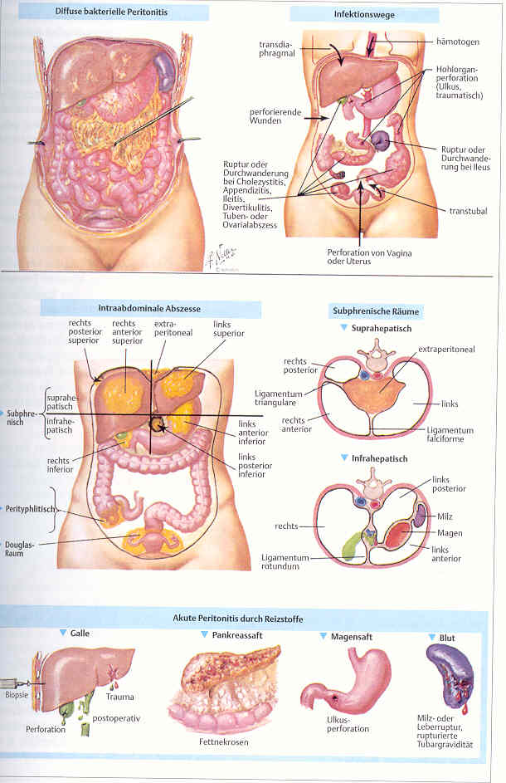

Slide 21
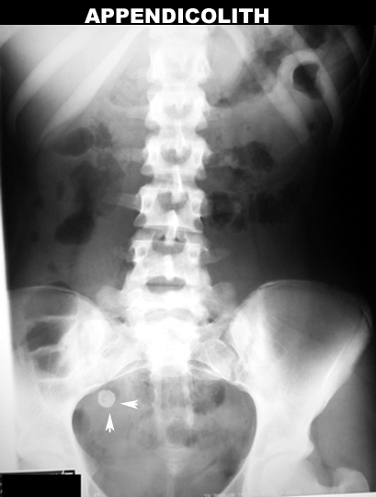

Slide 22
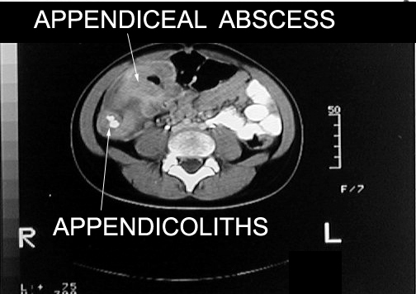

Slide 23
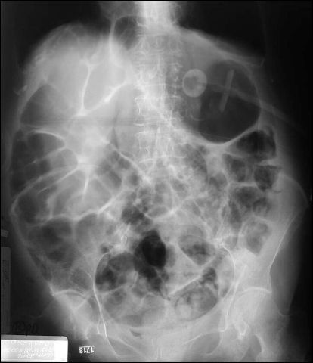
Gaseous distension

Slide 24


Slide 25
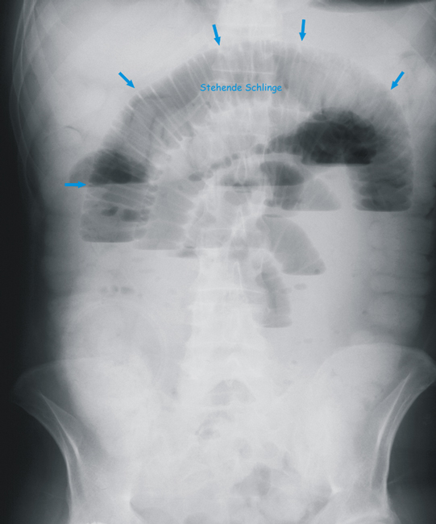

Slide 26
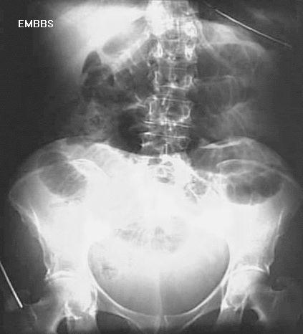
Gas shadow supine view

Slide 27
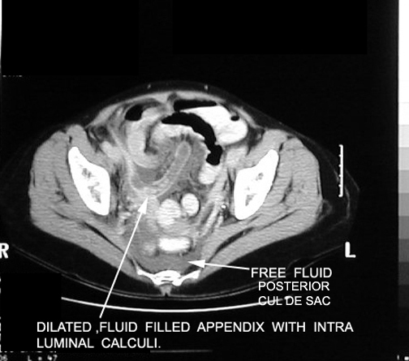

Slide 28
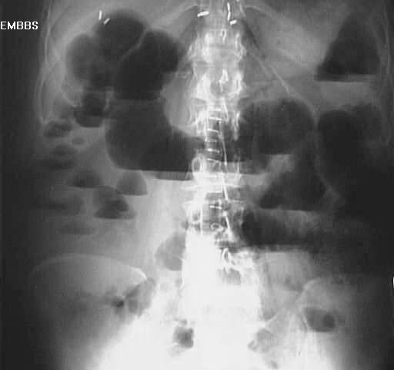
Multiple air fluid levels

