Slide 1
Multiple Choice Questions

Slide 2
Length of oesophagus is
25 cm
30 cm
20 cm
15 cm
25 cm

Slide 3
The liver is divided into Rt. Lobe and Lt.Lobe by
Ligamentum Teres
Round ligament
Falciform ligament
Coronary ligament
Ligamentum Teres

Slide 5
Normal sperm count in semen is
50 – 100 million / ml
50 – 150 million / ml
100 – 150 million / ml
100 – 200 million / ml
50 – 100 million / ml

Slide 6
In the epididymis and deferent duct the spermatozoa mature more and are capable of independent movement through liquid medium.
An ejaculation usually consists of 2 to 5 ml of semen
Containing 40 to 100 million spermatozoa per ml
If they are not ejaculated spermatozoa are reabsorbed by the seminiferous tubules
The stored sperms can retain their fertility for several months.
During ejaculation the muscle in the walls of the deferent duct contracts, propelling the spermatozoa towards the urethra

Slide 7
Which one gives support to the breast
Coronary ligament
Ligamentum Bigalow
Falciform ligmentum
Cooper’s ligament
Cooper’s ligament

Slide 13
Y – shaped ligament of Bigelow – Iliofemoral ligament

Slide 14
Y – shaped ligament of Bigelow – Iliofemoral ligament

Slide 16
Development of placenta occurs during the ------------- month of pregnancy :
I st
II nd
III rd
IV th
IV th month

Slide 17
By the beginning of the fourth month, the placenta has two components a) a fetal portion, formed by the chorion frondosum and b) a maternal portion by the decidua basalis

Slide 18
Keratosis

Slide 20
somatostatin is secreted by
a) Alpha cells
b) Beta cells
c) F cells
d) Delta cells
Delta cells

Slide 21
The cells which make up the pancreatic islets (islets of Langerhans) are found in clusters .
they are distributed irregularly throughout the substance of the pancreas
3 main types of cells
α cells secrete glucagon
β cells secrete insulin
δ cells secrete several substances including Somatostatin

Slide 22
Abdominal cavity contains all except
Kidneys
Urinary Bladder
Small intestine
Large intestine
Urinary Bladder

Slide 23
Urinary bladder is contained in the pelvic cavity

Slide 24
Floor of the femoral Triangle is not formed by
Pectineus
Adductor longus
Iliacus
Adductor brevis
Adductor brevis

Slide 29
All are major salivary glands except
Parotid
Buccal
Submandibular
sublingual
Buccal

Slide 32
The visible portion of tooth above the level of gum is called
Gingiva
Dentine
Crown
Cementum
Crown

Slide 34
All are regions of the stomach except
Pylorus
Fundus
Hilus
Cardia
Hilus

Slide 36
Endothelium lined spaces present in the liver is called
Sinusoids
Bile canaliculi
Cystic duct
Lobule
Sinusoids

Slide 38
Duodenal gland is otherwise known as
Duct of Santorini
Kupffer’s gland
Brunner’s gland
Crypts of Lieberkuhn
Brunner’s gland

Slide 39
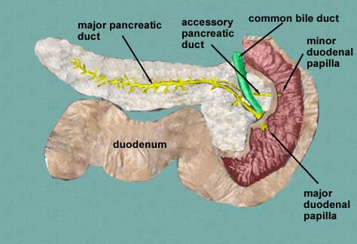
major pancreatic duct of Wirsung
Accessory pancreatic duct of Santorini

Slide 40
How many minor calyces are present in the kidney?
2-3
5-9
8-18
20-25

Slide 43
The parenchyma of each kidney usually drains into seven calyces, three in the upper and two each in themiddle and lower calyces.
Each of the three segments represents an anatomical and physiologically distinct unit with its own blood supply
- Bailey & Love’s
Short Practice of Surgery

Slide 44
Brunner’s glands are mucous glands. Their ducts pierce the muscularis mucosae to open in the depths of the crypts of Lieberkuhn

Slide 45
Length of small intestine in living person averages about
6.5 m
5 m
4.5 m
3 m

Slide 46
The small intestine is continuous with the stomach at the pyloric sphincter and leads into the large intestine at the ileocaecal valve.
It a little over 5 metres long and lies in the abdominal cavity surrounded by the large intestine. In the small intestine the chemical digestion is completed and most of the absorption of nutrient materials takes place.
Three parts – duodenum – 25 cm curves around the head of pancreas
Jejunum – 2 metres
Ileum – 3 metres

Slide 47
All are the parts of epididymis except
Head
Body
Tail
acrosome
acrosome

Slide 48
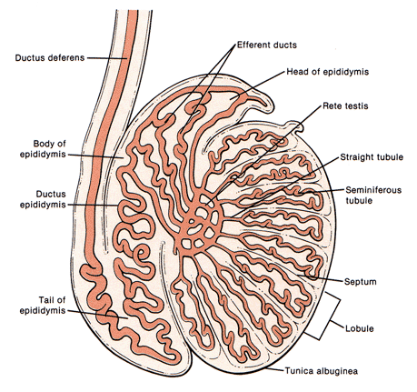

Slide 49
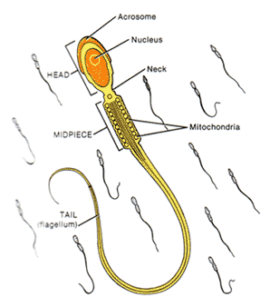

Slide 50
Ureter is lined by
Stratified squamous epithelium
Pseudostratified epithelium
Cuboidal epithelium
Transitional epithelium
Transitional epithelium

Slide 57
The palatine tonsils are found in the
Trachea
Oropharynx
Nasopharynx
Larynx
Oropharynx

Slide 60
External urethral sphincter is composed of
Longitudinal smooth muscle
Transverse smooth muscle
Circular smooth muscle
Skeletal muscle
Skeletal muscle

Slide 61
The sphincter urethrae muscle is often called the ‘external sphincter’.
It is capable of maintaining continence of urine.
It is a broad band of loosely packed muscle fibres which surround the membranous rurethra spindle fashion
Most fibres are attached laterally to the pubic ramus. They consist of U-shaped loops behind and in fron of the urethra; som, however, freely encircle the urethra while others pass backwards to mingle with the fibro-muscular tissue of the perineal body

Slide 66
Pancreatic duct is otherwise known as :
Ampulla of Vater
Duct of Santorini
Duodenal Papilla
Duct of Wirsung
Duct of Wirsung

Slide 71
Which of the following is not included in the femoral triangle?
Femoral Artery
Femoral Nerve
Femoral Vein
Femoral Ligament
Femoral Ligament

Slide 76
Which of the following supplies the muscles of the perineum?
Pudendal nerve
Sciatic nerve
Femoral nerve
Tibial nerve
Pudendal nerve

Slide 78
Which of the following supplies the muscles of the perineum?
Pudendal nerve
Sciatic nerve
Femoral nerve
Tibial nerve
Pudendal nerve

Slide 79
Which of the following is not a specific element of duodenal ulcers?
Primarily affects males
Occasional malignancy
Can lead to weight gain
Affects people over 65
xxxxxxxxxxxx

